Slide 1
Appendix: Python and OpenCV
Python was developed in the 1990s by
Guido van Rossum
○ Versions:
Python 1.1 – 1.5,
Python 1.5.2 (1999.4)
----------------------------------------------------
Python 3.6.7 (2018.10.20)
○ Download
Google → Search “Python”
https://www.python.org/ → Download
-<number>

Slide 2
○ Installation
python-3.1.4.msi
windows x86-64
MSI installer (3.1.4)[1](sig)
c:\python31\ …………………………
Finish
○ References
N. Ceder, “The Quick Python Book,
2nd Edition,” 2010.
2. M. Lutz, “Learning Python,” 2013.
2-<number>

Slide 3
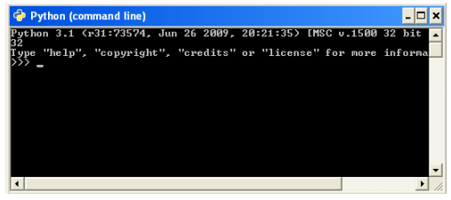
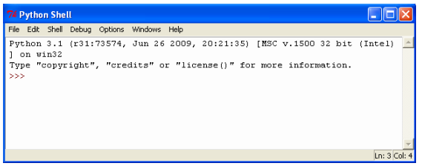
○ Interfaces
Command-line mode
(2) Integrated development environment (IDLE)
2-<number>

Slide 4
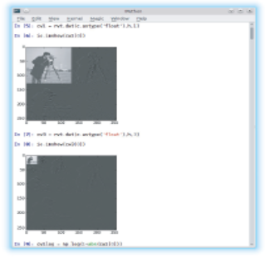
(i) IPython: Includes Syntax highlighting,
Automatic indentation, Inline graphics
2-<number>

Slide 5
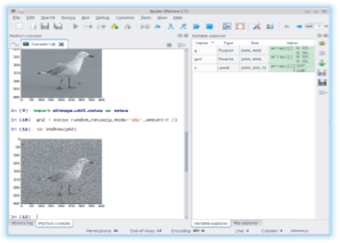
(ii) Spyder: A graphics development environment
with integration of numpy, scipy, matplotlib,
iPython including a variable and file browser,
integrated editor, interface to Python debugger
2-<number>

Slide 6
○ Libraries:
Installation: pip3
Standard library:
Mathematics, Internet protocols, Multimedia,
System interfaces, File and data handling,
Graphics interface design
Most used libraries:
SciPy (Scientific Python) :
Modules for optimization, Numerical analysis,
Signal and image processing,
Diferential equation solvers.
2-<number>

Slide 7
numpy (Numerical Python) :
Routines for array manipulation,
Functions for operating on arrays.
matplotlib (Plotting library) : plotting tools.
cv2 (Opencv) : functions for IP and CV.
Many functions have to be imported either by
importing their libraries or the functions needed
2-<number>

Slide 8
B.1 Basic Use
Prompt: (a) IDLE - >>>, (b) iPython - In [#]:
Arithmetic:
// - integer division
^ - bitwise conjunction
** - exponentiation
Examples:
In : 37+42
Out : 79
In : 2**67 - 1
Out : 147573952589676412927L?
2-<number>

Slide 9
In : 1.0/7
Out : 0.14285714285714285
In : 11/7
Out : 1
In : 11.0/7
Out : 1.57142857142857714
In : 11.0//7
Out : 1.0
* Python returns a value of the same type as the input
2-<number>

Slide 10
Mathematical functions, in math, must be loaded
(by import) before they are available
In : import math
(import the math library)
Individual libraries (e.g., sqrt) are called as
(math.sqrt)
In : math.sqrt(3.0)
Out : 1.7320508075688772
In : from math import exp
In : exp(1.5)
Out : 4.4816890703380645
2-<number>

Slide 11

In : from math import
(import all libraries )
In : sqrt(3.0)
Out : 1.7320508075688772
In : sin(pi/6)
Out : 0.49999999999999994
In : cos(pi/12)
Out : 0.9659258262890683
Import library with an alias
In : import math as m
In : m.tan(pi/8)
Out : 0.41421356237309503
2-<number>

Slide 12
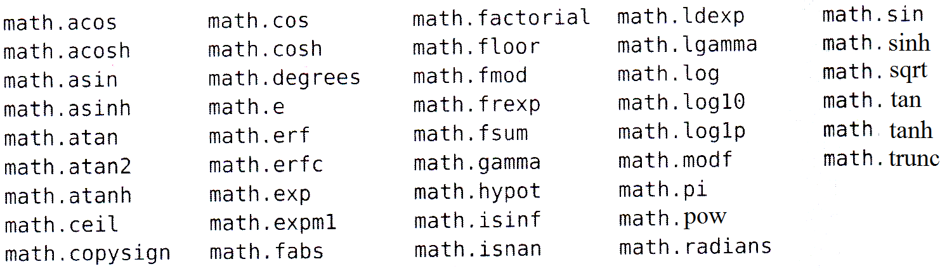
To see all math functions
In : math. tab
B.2 Arrays
An array can be entered using array from numpy
In : import numpy as np
In : A = np.array([[1,2,3], [4,5,6], [7,8,9]])
2-<number>

Slide 13
In : A
Out : array( [ [1, 2, 3],
[4, 5, 6],
[7, 8, 9] ] )
In : print A
Out : [ [1 2 3],
[4 5 6],
[7 8 9] ]
In : A**3
Out : array( [ [ 1, 8, 27],
[ 64, 125, 216],
[343, 512, 729] ] )
2-<number>

Slide 14
In : A**(0.5)
Out : array( [ [1. , 1.41421356, 1.73205081],
[2. , 2.23606798, 2.44948974],
[2.64575131, 2.82842712, 3. ] ] )
In : np.sqrt(A)
Out : array( [ [1. , 1.41421356, 1.73205081],
[2. , 2.23606798, 2.44948974],
[2.64575131, 2.82842712, 3. ] ] )
In : B = A – 1
In : print A.dot(B)
Out : [ [24 30 36],
[51 66 81],
[78 102 126] ]
2-<number>

Slide 15
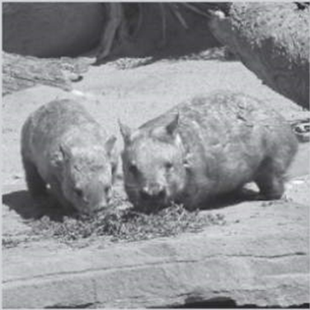
B.3 Image I/O
Input images
In : import skimage.io as io
In : w = io.imread (‘wombats.png’)
This takes the grayscale
image “wombats.pgn”
and puts it into array w.
In : io.imshow (w)
This shows array w as a
grayscale image.
2-<number>

Slide 16
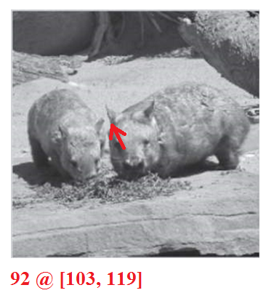
In : from skimage.viewer import ImageViewer as IV
In : viewer = IV(w)
In : viewer.show ( )
Interactive display using
ImageViewer method
In : io.imshow (‘wombats.png’)
Directly display the image
2-<number>

Slide 17
Save a color image to a matrix
In : b = io.imread(‘wombats.png’)
See the number of rows, columns, and “pages”
of b, which can be thought of as being a stack
of three matrices, each of the same size.
In : b.shape

Slide 18
To see the color values at a point.
In : print b[99, 199, :]
[114, 126, 58]
An indexed image is automatically converted
to a true-color image
In : em = io.imread(‘emu.pgn’)
In : em.shape
Out: (384, 331, 3)
where ‘emu.pgn’ is an indexed image, which
Consists of two matrices: a color map and an
Index to the color map.

Slide 19
To obtain values at a pixel
In : print em[108, 60, :]
[148, 138, 130]
In : np.set_printoptions(precision = 4)
In : print em[108, 60, :].astype(float)/255.0
[0.5804, 0.5412, 0.5098]

Slide 20
Output images
Write an image array x to an image file.
In : io.imsave (x, ‘filename.abc’)
where abc = gif, jpg, tif, or bmp
Write image array c to a PGN image.
In : io.imsave (c, ‘camerman.pgn’)
2-<number>

Slide 21
Face detection with OpenCV
and deep learning
# Import packages
import numpy as np
import argparse
import cv2
# Construct the argument parse and parse the arguments
ap = argparse.ArgumentParser()
ap.add_argument("-i", "--image", required=True,
help="path to input image")
ap.add_argument("-p", "--prototxt", required=True,

Slide 22
help="path to Caffe 'deploy' prototxt file")
ap.add_argument("-m", "--model", required=True,
help="path to Caffe pre-trained model")
ap.add_argument("-c", "--confidence", type=float, default=0.5,
help="minimum probability to filter weak detections")
args = vars(ap.parse_args())
# Load serialized model from disk
print("[INFO] loading model...")
net = cv2.dnn.readNetFromCaffe(args["prototxt"], args["model"])

Slide 23
# Load the input image and construct an input blob for
# the image by resizing to a fixed 300x300 pixels and
# then normalizing it
image = cv2.imread(args["image"])
(h, w) = image.shape[:2]
blob = cv2.dnn.blobFromImage(cv2.resize(image,
(300, 300)), 1.0,
(300, 300), (104.0, 177.0, 123.0))
# Pass the blob through the network and obtain the # detections and predictions

Slide 24
print("[INFO] computing object detections...")
net.setInput(blob)
detections = net.forward()
# Loop over the detections
for i in range(0, detections.shape[2]):
# Extract the confidence (i.e., probability) associated
# with the prediction
confidence = detections[0, 0, i, 2]
# Filter out weak detections by ensuring `confidence`
# is greater than the minimum confidence
if confidence > args["confidence"]:

Slide 25
# Compute the (x, y)-coordinates of the bounding
# box for the object
box = detections[0, 0, i, 3:7] * np.array([w, h, w, h])
(startX, startY, endX, endY) = box.astype("int")
# Draw the bounding box of the face along with the
# associated probability
text = "{:.2f}%".format(confidence * 100)
y = startY - 10 if startY - 10 > 10 else startY + 10
cv2.rectangle(image, (startX, startY), (endX, endY),
(0, 0, 255), 2)

Slide 26
cv2.putText(image, text, (startX, y),
cv2.FONT_HERSHEY_SIMPLEX, 0.45, (0, 0, 255), 2)
# Show the output image
cv2.imshow("Output", image)
cv2.waitKey(0)
Command line:
$ python detect_faces.py --image rooster.jpg
--prototxt deploy.prototxt.txt \--model res10_300x300_ssd_iter_140000.caffemodel

